Slide 1


CHARGE Edu-Tech Intern’s
CHARGE Edu-Tech Internship
Name- ANIKET KUMAR PANDEY
Cloud Computing Intern
Batch- April 2023

Slide 2
Project-1 Cloud Based Book Store.
There’s A Book for that! is an online book store and is a web-based system that is developed using PHP, Bootstrap and MySQL for the database. This includes an admin section and the user section. It aims to improve the selling of books through online as the Internet plays an important role in people’s day to day life.
It is very useful and time saving for book sellers to sell their books online and earn a lot of profit out of it. Having an Online Book Store is more efficient, provides convenience and minimizes effort compared to the traditional bookstore. In this Online Book Store once the user has log in into the system he can search for books in different category and each category contains a sub category where the user can look further. If he has already chosen a book to purchase he can place his order and proceed for checkout.

Slide 3
Features.
Add New Book
Publisher
List of Books
Purchase Books
Add to Cart
Payments
Fill Up Customer Information
Fill Up Payment Details
Contact Us

Slide 4
There’s A Book For That!.
Language: PHP, Html
Database: My SQL
Design Interface: Bootstrap Javascript, Html, Ajax, JQuery
Browser: Microsoft Edge
Software: XAMPP
Copy and Paste all the files from the GitHub Repository in a Folder Named Bookstore.
And Paste this folder in the inside Root directory where xampp was installed. Ex. In local disk C: paste in xampp/htdocs.

Slide 5
To Execute
Open PHPMyAdmin http://localhost/phpmyadmin/
Create database named- sourcecodester_bookstoredb.
Import book_shop_db.sql file given in the Repository
Run the script http://localhost/bookstore/ -HomePage
http://localhost/bookstore/admin.php -AdminLoginPage
in any Browser.
Accessing admin accounts
Username: admin Password: admin

Slide 6
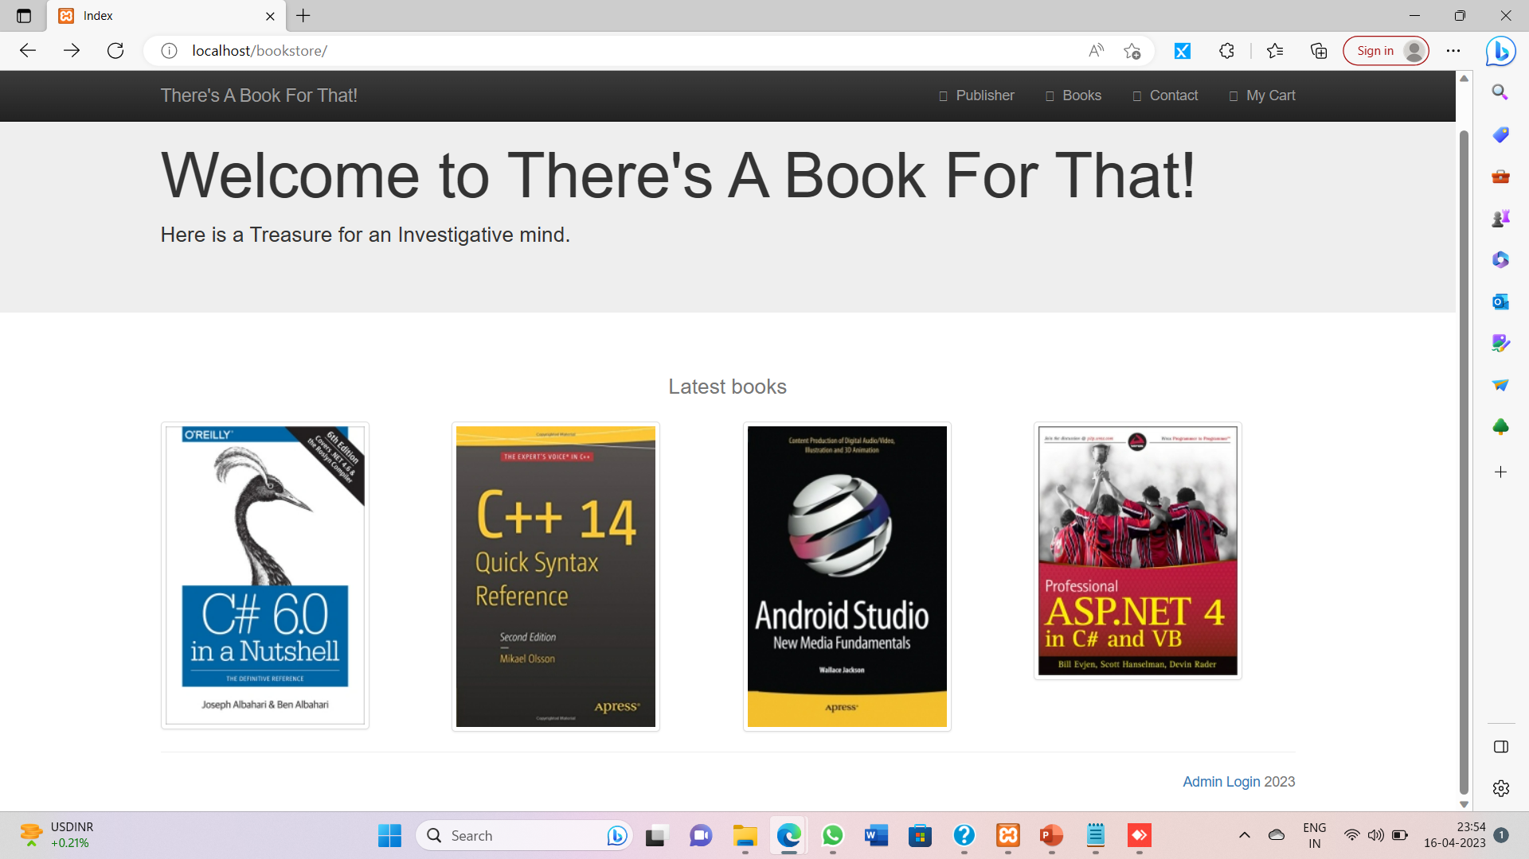
Snapshots.

Slide 7
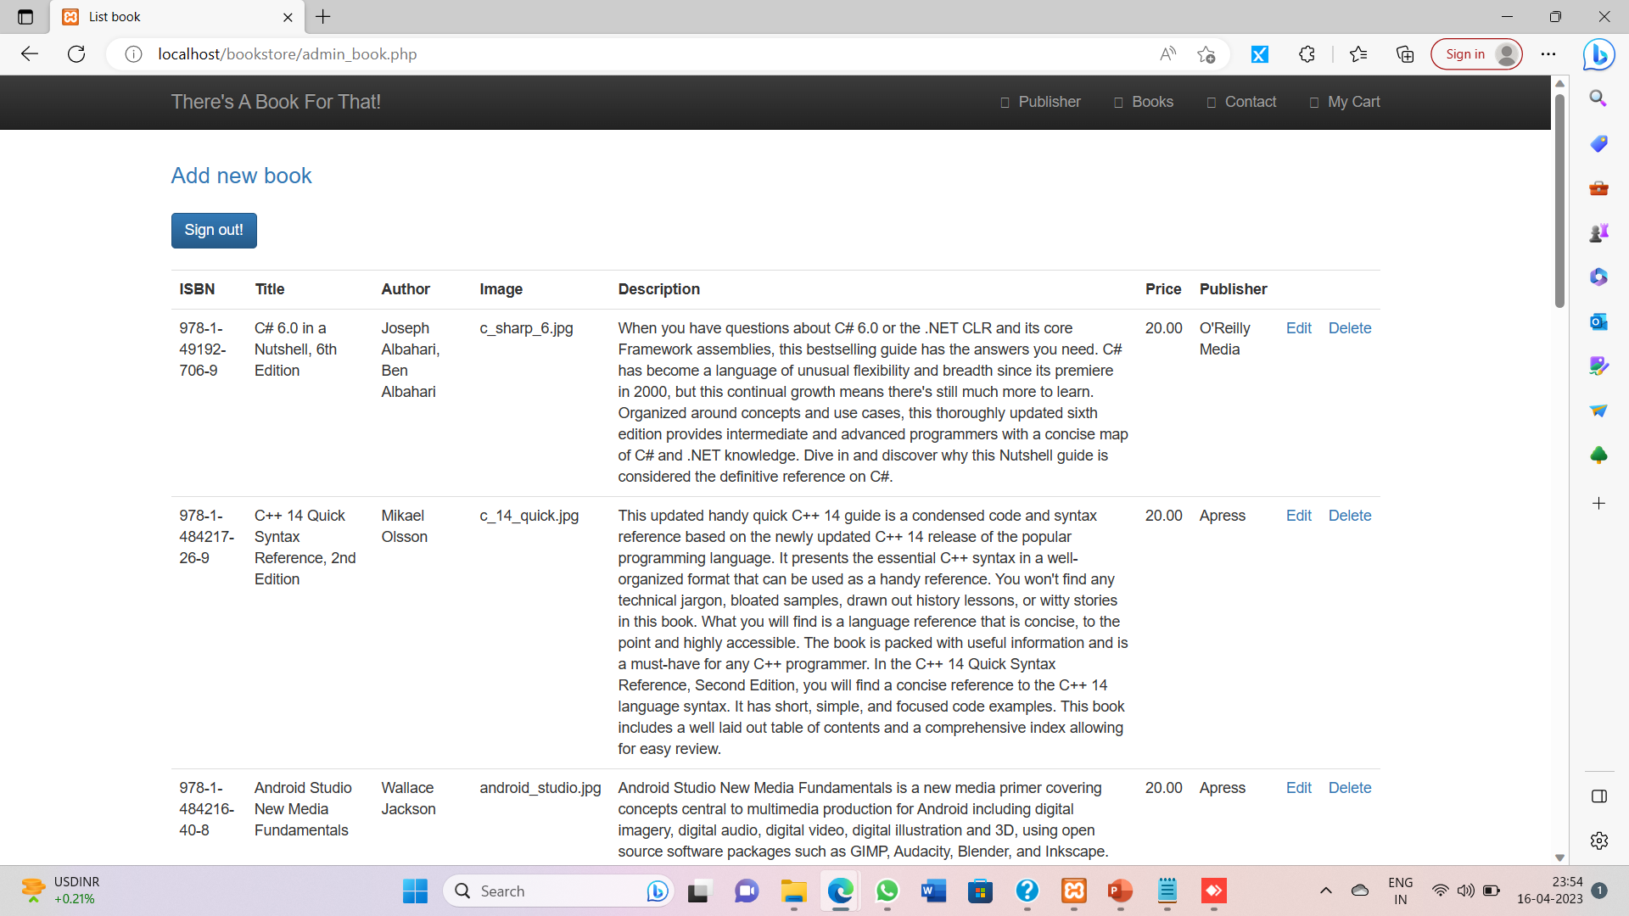
Snapshots.

Slide 8
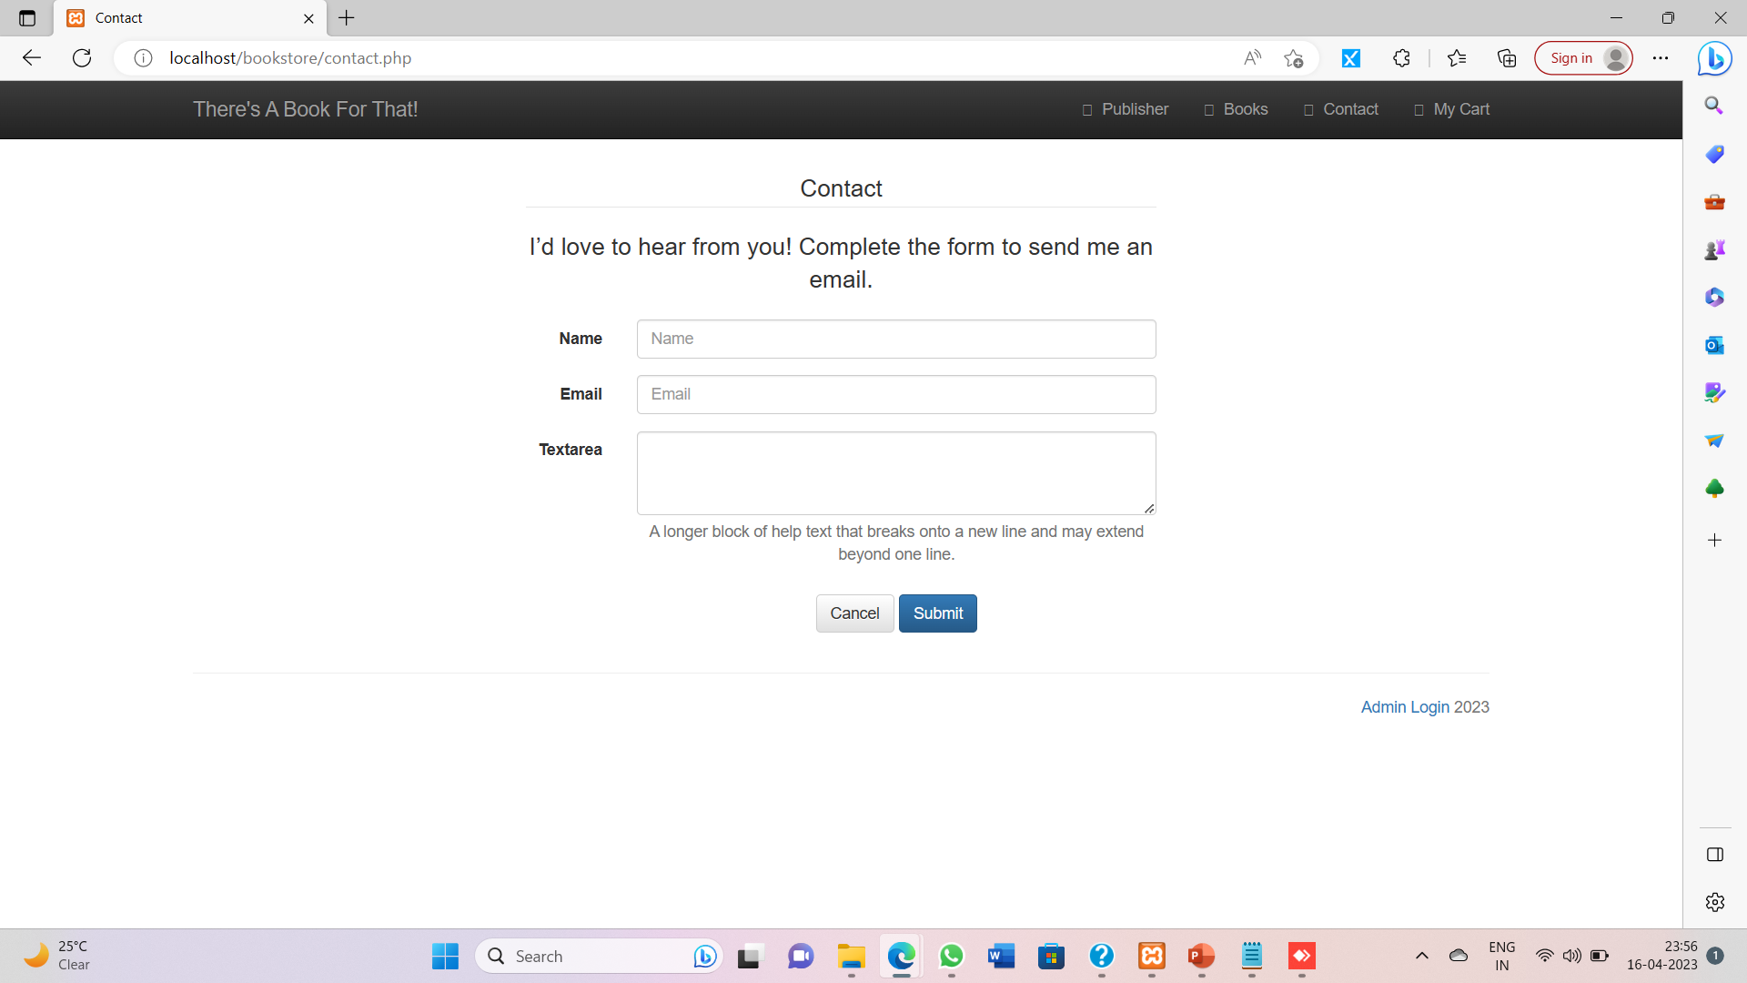
Snapshots.

Slide 9
Thank You

